Slide 1
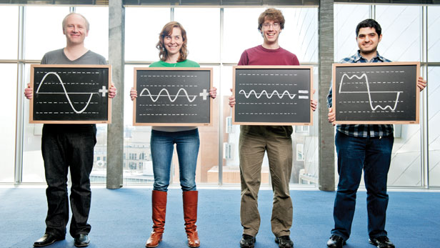
Fast Fourier Transform with Java
Fast Fourier Transform, IoT, Java, and AWS

Slide 2


Slide 3

Because we can… build (almost) anything!

Slide 4
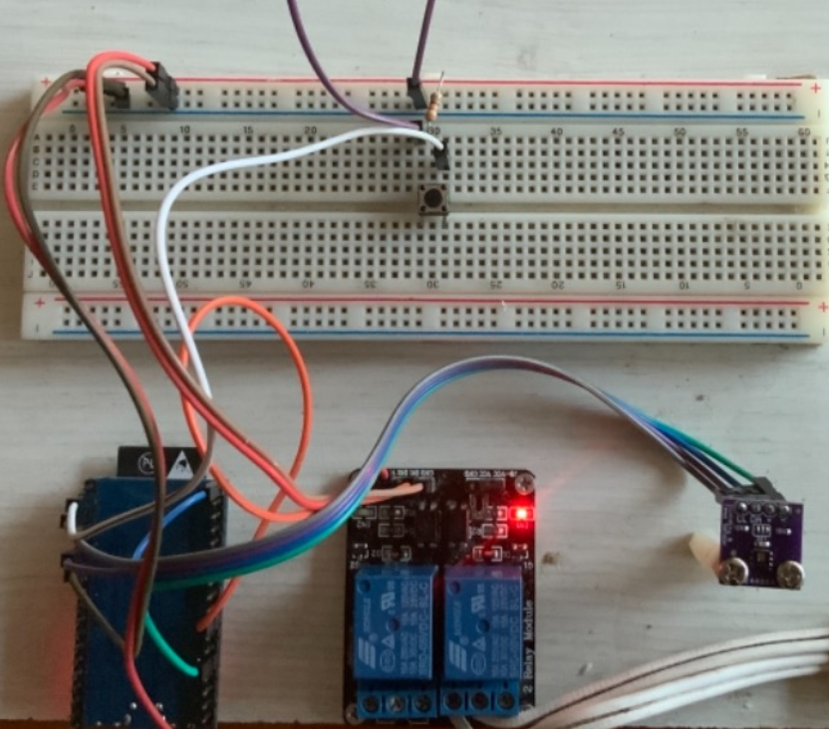
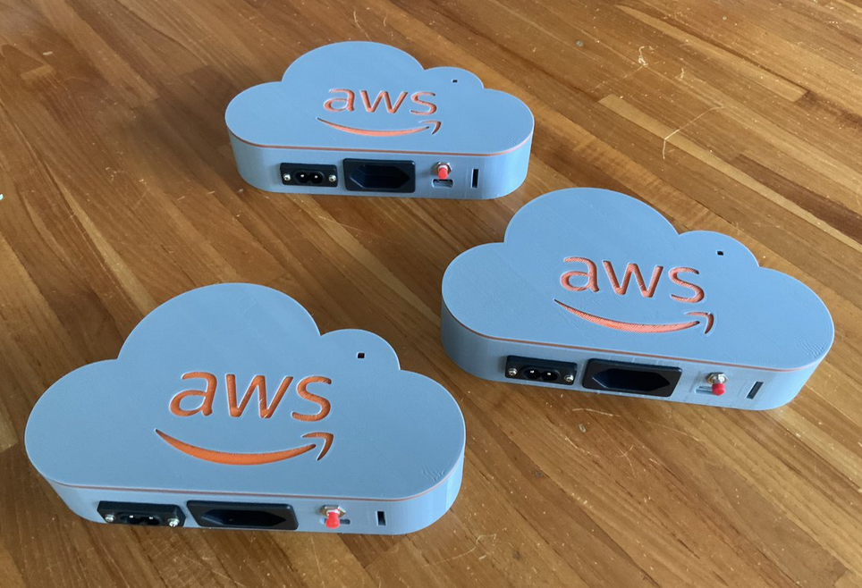
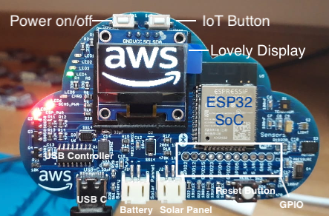
AWS Playground IoT Devices
All open-source and & D.I.Y.: ESP32, +Sensors, +Actuators – created in LATAM!
https://aws.amazon.com/developer/learning/lets-build-iot/
https://github.com/vsenger/Playground4AWS
https://github.com/vsenger/Playground4IoT/
Notes:
Napoleon startup

Slide 5
Demo: turn on / off a lamp with AWS IoT Core
Notes:
Napoleon startup

Slide 6

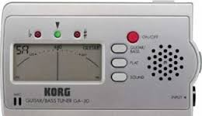
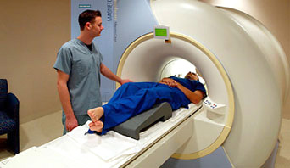
Fourier Transform is everywhere!
Guitar Tuner, image recognition, brain signal processing, cryptography, etc.
AI/ML – identify data / objects simetry in DL
Notes:
“métematixian and fisicist” – oh ingles brabo judia de mim ahahah

Slide 7
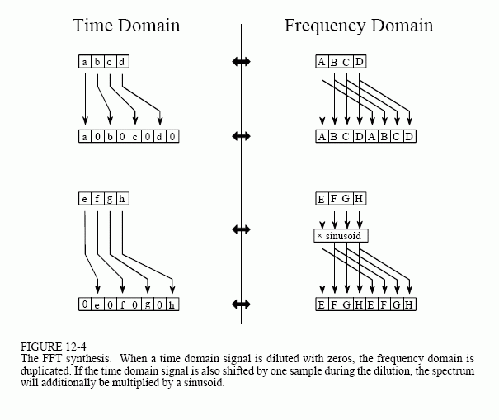
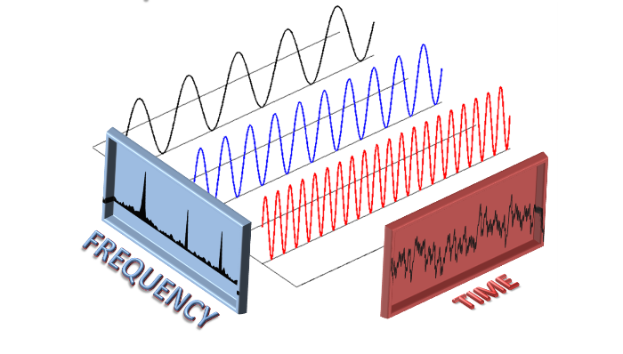
Temporal function (a sign) into frequency
FFT decomposes temporal function (a sign) into frequency

Slide 8
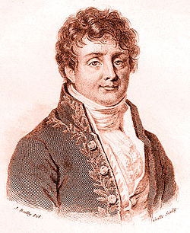
Who created Fourier Transform?
Joseph Fourier - French - 1768 - 1830
Mathematician and physicist
Smart French guy
Responsible for many math we use Today in tech, including AI/ML
Thanks Fourier!

Slide 9
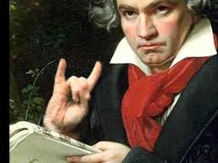
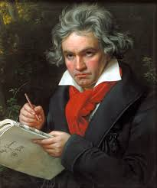
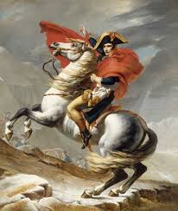
Fourier + Napoleon + Beethoven = amazing combo!
Napoleon Bonaparte’s scientific advisor
Napoleon + Fourier + Beethoven =THE SQUAD
Notes:
Look at this squad... Napoleon, Beethoven, Fourier... And the horse!!!!

Slide 10

How to do Fourier Transform with your programming language?

Slide 11
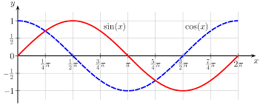
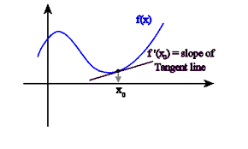
Lots of Sine and Cosine, derivative, etc..

Slide 12


Slide 13

Processing.org + FFT
Java (DSL) programming tool to code apps for visual artists
Processing.org = Father of Arduino IDE
Small code and big results
Minim is a nice FFT library for Processing

Slide 14
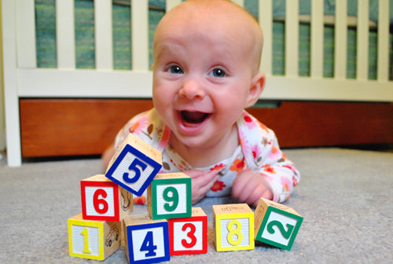
Don’t worry, use libraries and be happy!

Slide 15
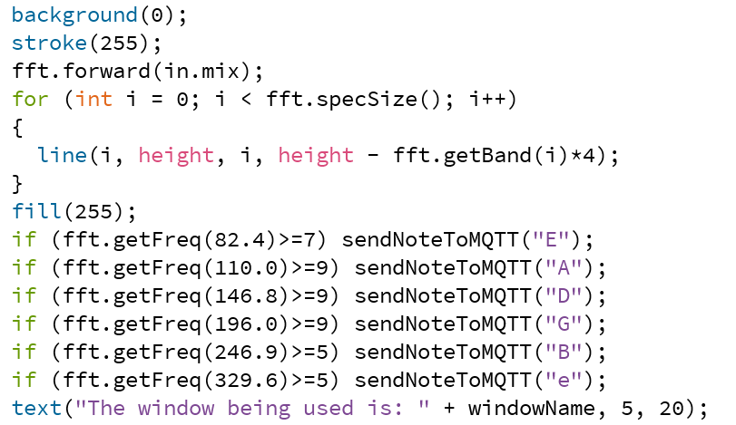
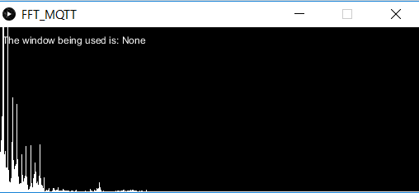
Processing.org + FFT

Slide 16
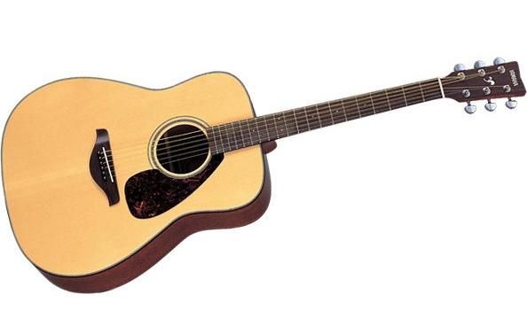
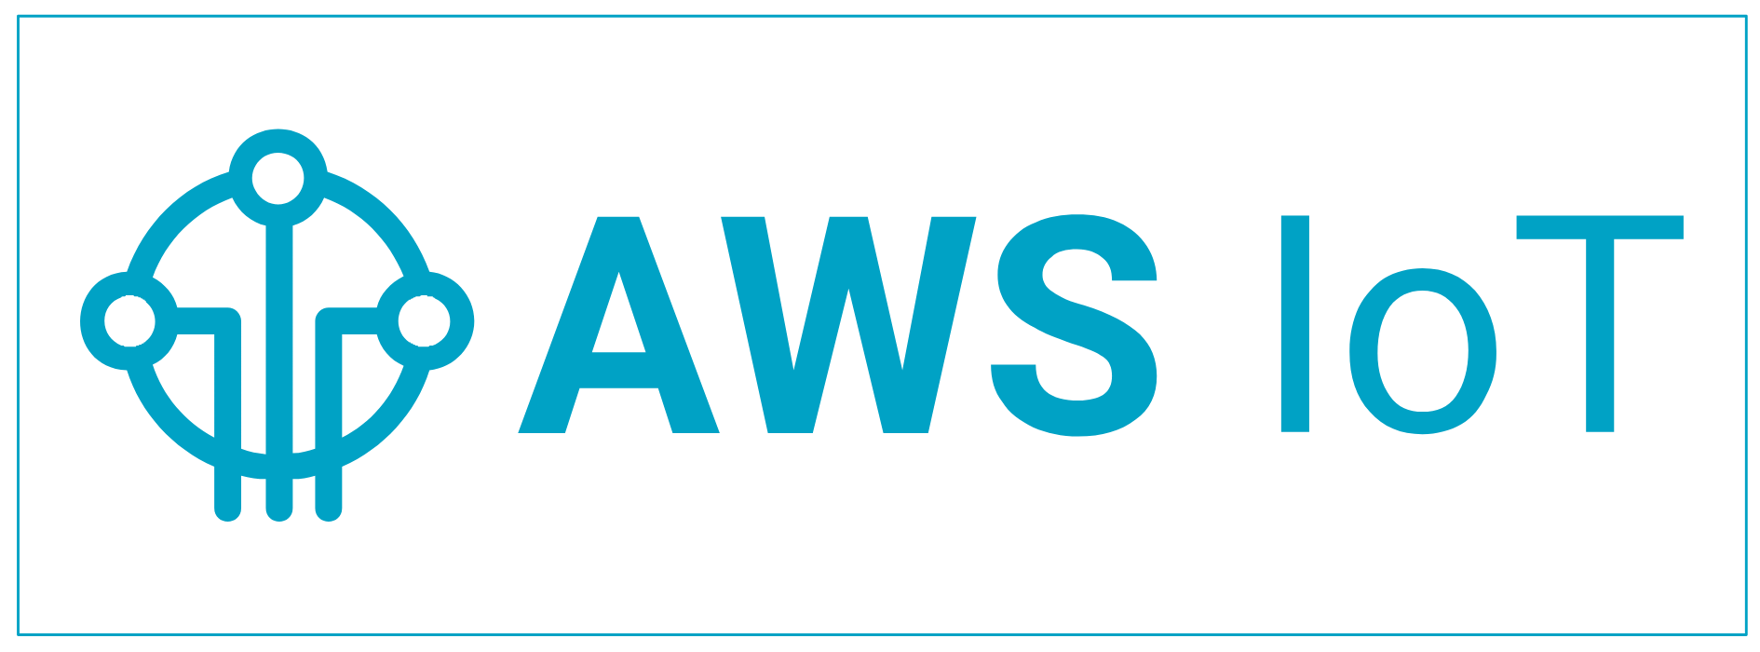

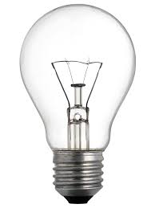
DEMO: Light control using Guitar, Ukulele, Violin, Flute…

Slide 17
Minecraft Forge Mod

Slide 18
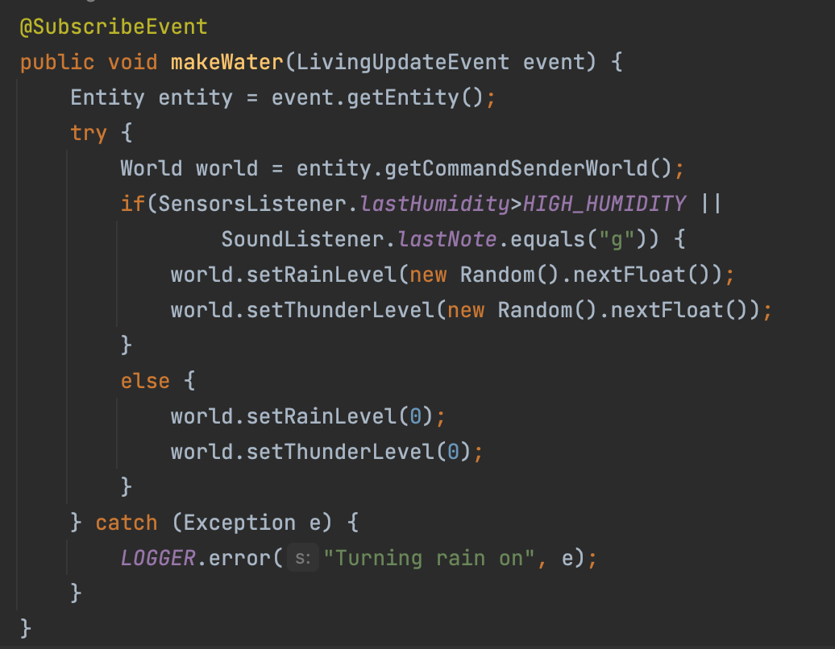
Minecraft Forge Mod Code

Slide 19

Let’s play!

Slide 20
Links
Playground4AWS: github.com/vsenger/Playground4AWS
Playground4IoT: github.com/vsenger/Playground4IoT
Playground4Robotics: github.com/vsenger/Playground4Robotics
Processing.org
Notes:
Java is (cool!) everywhere, just dive deep
Math is not / can be not boring if you are learning and being curious
Having your hands dirt is being right a lot!

Slide 21
Summary
Java is (cool!) everywhere!
Fourier is everywhere
Math is cool (specially when you have libraries ☺)
Infinite possibilities: gaming, IoT, AI/ML, Java etc.

Slide 22
The questions is… WHY????

Slide 23

Because we are builders and we can build anything!
Thank YOU!
Vinicius Senger @vsenger

